Slide 1



Stony Brook University
School of Nursing
Registered Nurse Baccalaureate Program
Virtual Information Session
Kathleen M. Gambino EdD, RN
School of Nursing

Slide 2
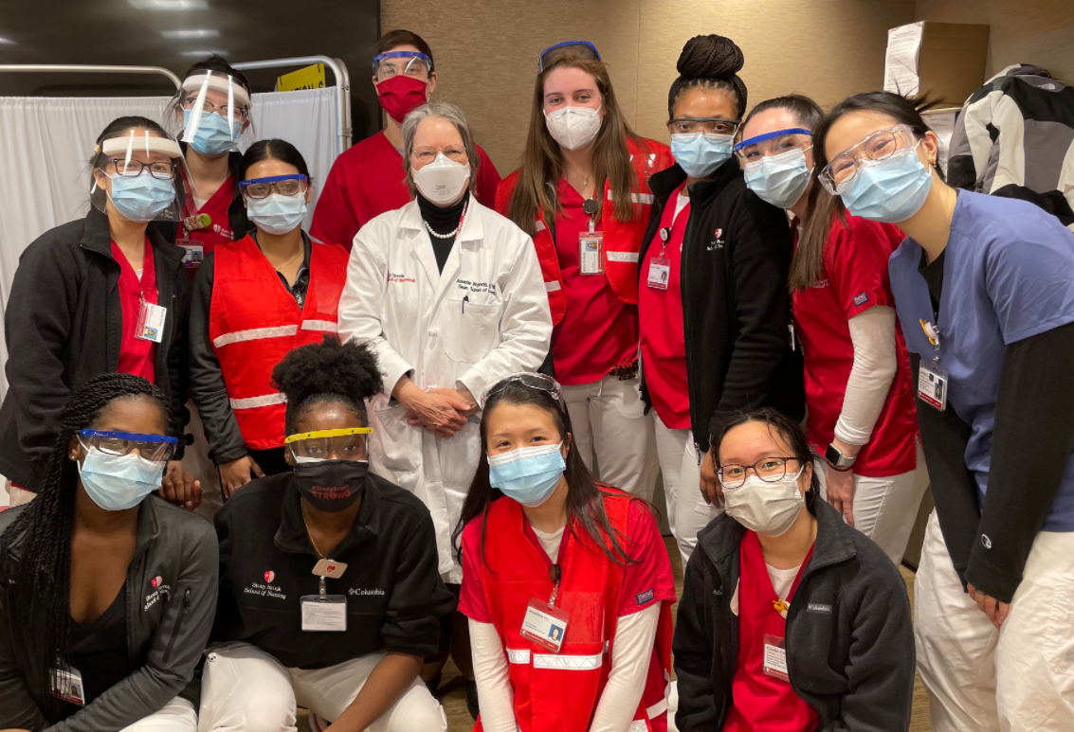
The Registered Nurse to Baccalaureate Degree Program (RNBP) is designed for students with either an associate's degree or diploma in nursing. The curriculum is concentrated in upper-division Nursing and Liberal Arts courses
and leads to a
Bachelor of Science degree with a major in Nursing
SBU Nursing Degree

Slide 3

Faculty available onsite and online
Not a competitive admission process, no interviews or testing
No limit to the number of students accepted
A predominately online asynchronous program
Currently there are two onsite days and one virtual synchronous day. (6-8 weeks notice given for all mandatory days)
All courses are offered through the SON
Seats for all required classes are guaranteed (You can’t be closed out of a required course.)
RN license is not required to begin the program
Brightspace learning platform
New York State tuition
Stony Brook University’s SON reputation
Fully accredited program
Benefits of SBU RN to Baccalaureate Program

Slide 4

Associate’s degree or diploma in nursing
A cumulative GPA > 2.5 from all schools attended (including Advanced Placement courses)
60 credits from your previous coursework with a grade of C or better
Prerequisite courses do not age out.
Please see our website for additional information:
https://nursing.stonybrookmedicine.edu/rnProgram
Admission Requirements

Slide 5
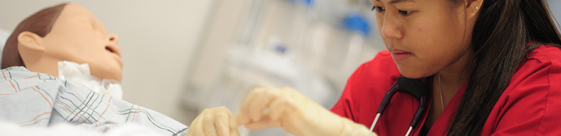
An RN license is not required prior to starting the program.
New graduates are given up to 6 months to pass the NCLEX exam.
RN Licensure

Slide 6
Required Courses* | Credits
Lower Division Clinical Nursing Courses | 30
English Composition | 3
Intro to Psychology | 3
Microbiology/Lab | 4
Anatomy and Physiology I/Lab | 4
Anatomy and Physiology II/Lab | 4
Statistics | 3
Humanities | 3
US History | 3
Global Issues | 3
Total Credits | 60 minimum
Preadmission Coursework

Slide 7
The RN to Baccalaureate Program (RNBP) has one admission date:
Summer Session 1- which begins at the end of May
A virtual pre-recorded orientation program will be distributed in by mid-April.
All accepted students must listen to the entire orientation program and respond as directed.
Admission Date/Orientation

Slide 8

Part-time Pathway
2 - year pathway
3 - 11 credits per semester or session
Continuous pathway
Clinical courses are as follows:
HNC 340 – Novice to Expert
HNC 469 – Population Health
HNC 470 – Nursing Leadership Practicum: A Capstone Experience
Registered Nurse to Baccalaureate Pathway

Slide 9
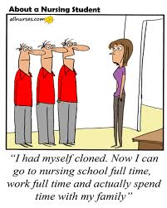
All students are accepted on the part-time pathway
The two-year, part-time pathway was developed for working RNs
Designed so that working students can do well and progress to competitive graduate programs.
If necessary, transition to a slower pathway is possible.
Why a Part-time Pathway?

Slide 10
Registered Nurse to Baccalaureate Program Curriculum

Slide 11

If you have a previous Baccalaureate degree in another discipline, you may be eligible to transfer up to 19 credits of your previous 300 & 400 level liberal arts courses to the RN to Baccalaureate Program, resulting in a decrease in the number of courses you must complete.
Official transcripts and course descriptions must be submitted to me and the SON Office of Student Affairs for consideration
Decisions regarding transfer credit are made on an individual basis
Previous Degrees and Credit Waivers

Slide 12
Applications open August 1st
Please check the website for application deadline dates
Online electronic application is only available through our website at:
https://nursing.stonybrookmedicine.edu/rnProgram (Click the Quick Link “Apply Now”)
Do not apply to Stony Brook main campus or use the SUNY common application
Unofficial transcripts from all colleges/universities ever attended must be uploaded onto the electronic application (must be readable transcripts)
All preadmission coursework must be completed with a grade of C or higher.
References – submitted electronically via the online application
  Email addresses of 3 professional references
  Vary your selection
  Family and friends are not acceptable
Personal statement/essay is required
Completion of all preadmission coursework is required prior to starting the program.
All outstanding preadmission coursework must be posted on the official transcripts and the official transcripts submitted after acceptance into the program. However, new associate degree graduates will be given additional time to submit their school of nursing transcripts.
No onsite interview and testing
Application Requirements

Slide 13
Minimum GPA = 3.0
At least one year of experience as a registered nurse in your clinical area of interest
You may be interviewed as part of the admission process
Conditional seat in a SON nurse practitioner program
Available for nurse practitioner programs only
Extremely competitive admission process
Contact me for additional information only if you meet the requirements stated above
RN/Baccalaureate to Masters Program

Slide 14
The online application will be available in August at:
https://nursing.stonybrookmedicine.edu/rnProgram
Check website for application deadline dates
Click on Apply Online under Quick Links
Applications are submitted directly to the School of Nursing
The Admissions and Academic Standards Committee and the Dean of the School of Nursing make final decisions regarding the selection of incoming classes
Application Location

Slide 15
You will need to provide:
The email addresses of three professional references
Unofficial transcripts from all programs attended
A personal statement
$50 application fee
Application Process

Slide 16
Those admitted will need to provide:
All official transcripts
Proof of BLS-AED
Health records and titers
Evidence of health insurance
Evidence of student malpractice
Evidence of completion of prerequisites
After Admission

Slide 17
Click on link below and select “Undergraduate” for the most recent per credit cost:
https://www.stonybrook.edu/commcms/bursar/tuition
Please note that other fees and charges apply.
Tuition

Slide 18

Financial Aid
Please contact the Financial Aid Office at:
https://www.stonybrook.edu/commcms/finaid/
Phone: 631-632-6840
Email: finaid@stonybrook.edu

Slide 19

  For additional information contact:
  Kathleen M. Gambino EdD, RN - Program Director for the Registered Nurse to Baccalaureate, RN/Baccalaureate to Master’s Program:
  Kathleen.Gambino@stonybrook.edu
Additional Information

Slide 20


